Slide 1

Health Analyzer
Keep track of your health using Health Analyzer with the help of certified Diet Consultants.

Slide 2
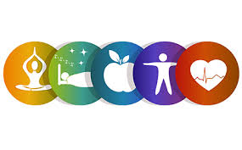
Content:
Description about application
Diet Consultant Modules
Track food intake
Ayurveda
Pictorial images of application
Technology used
Sources

Slide 3
Description about App:
This application is designed to keep the users healthy by tracking and recommending them the diet charts according to their health issues, deficiencies, and what they are consuming everyday.
This app will contain the certified practitioners assistant. These practitioners were verified by their respective departments of expertise.
User is required to feed the images of their food to keep the track of quality and quantity of food.
If user requires any pre-designed diet chart then he/she can select the chart according to their needs.
We have also added a separate section for ayurveda followers. Dietary charts, remedies, and solutions according to their doshas (vata, pita, and kapha) is provided.
User can also generate their weekly and monthly report of their diet.
And at the last to motivate users to stay consistent we have also added rewards option based on their performance.

Slide 4
Diet Consultant Modules
Given are the modules for the android artificial intelligence diet consultant system is:
User Module: In this module, the user have to login and make account and afterwards can enter his/her personal details in order to get advice from the android dietitian. User can also add certain symptoms about their health, if they have any, in order to get perfect solution.
Admin Module: Here, the admin will work, which takes care of submitting all the information related to diet for the users.
Doctor Module: Here, doctors can personally give advice to the users for the sake of some extra care. This information will displayed on the content area of the application, either if personal then in user’s account or else in an open area.
Database Module: In this module, all the details and information will be saved and a record is being here

Slide 5
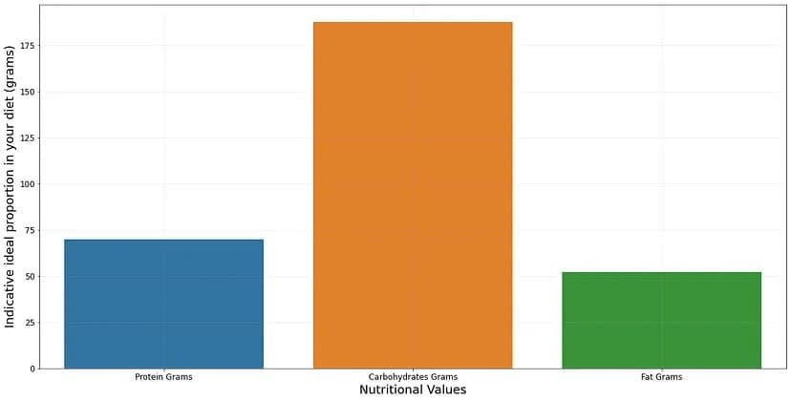
Track Food Intake
In this field, user is required to enter his daily food intake, according to the data entered by user application will plot a graph and the data points according to graph, application will provide the comments.
According to the data entered, using database application will generate the weekly or montly report on user’s demand.
For ex- We should get:-
One gram of protein per day per kg of the person (e.g. 70g of proteins per day if you’re a 70 kg person)
The carbohydrates should be half of the calories you assume per day.
The remaining part should be fat
Fat, Carbohydrate and Proteins for a 70 kg person with 1500 calories should be something like this :
Tracking and plotting is done using MATPLOTLIB library.
And optimization is done using simplex algorithm using minimum and maximum function.

Slide 6
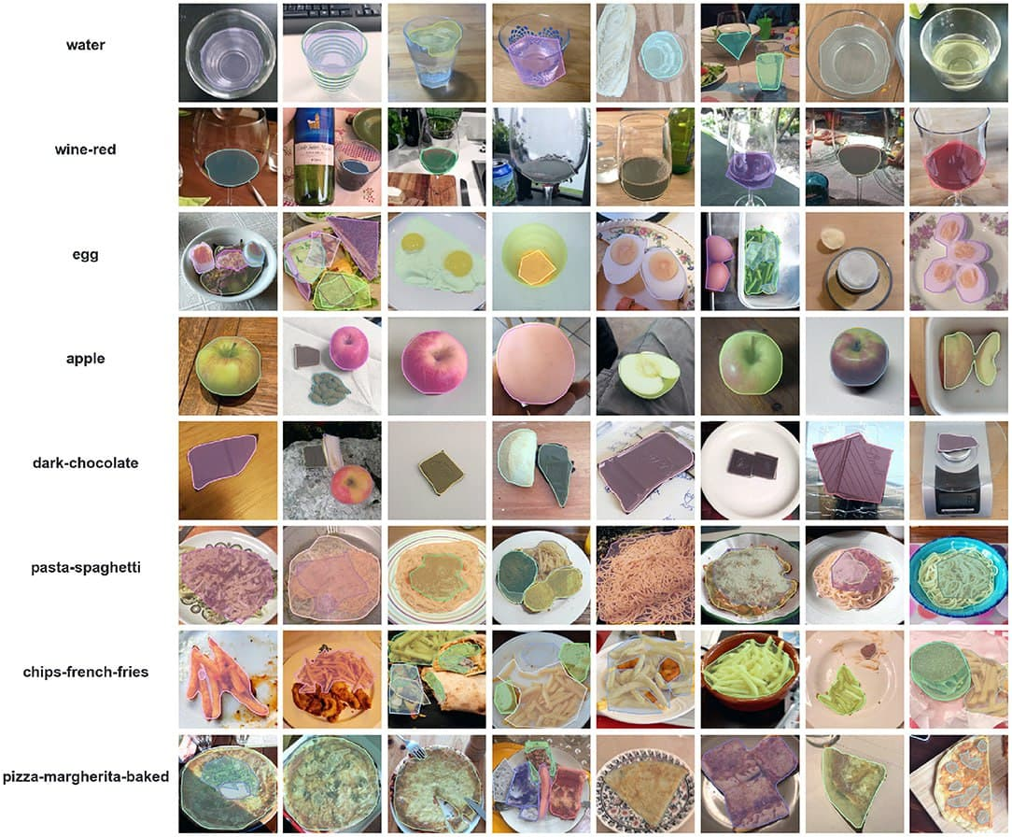
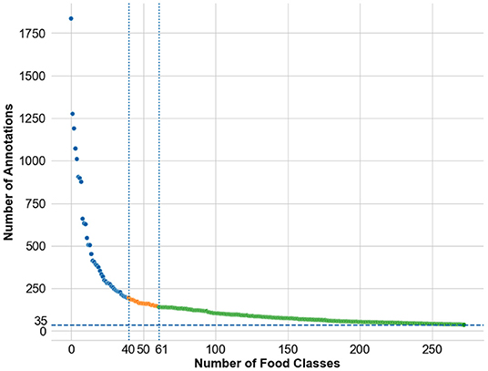
Image recognition
We have used github project MyFoodRepo-273 for this purpose.
MyFoodRepo app used in research cohorts. Through four rounds, the benchmark released the MyFoodRepo-273 dataset constituting 24,119 images and a total of 39,325 segmented polygons categorized in 273 different classes. Models were evaluated on private tests sets from the same platform with 5,000 images and 7,865 annotations in the final round. Top-performing models on the 273 food categories reached a mean average precision of 0.568 (round 4) and a mean average recall of 0.885 (round 3), and were deployed in production use of the MyFoodRepo app.
Sample images and corresponding annotations for some of common food classes in myFoodRepo dataset.
Distribution of number of annotations available across the food classes in the dataset. The individual food class names are not mentioned for readability. The public release of the dataset was done in three phases—the first phase of the public release consisted of the images from the top-40 classes, the second phase of the public release consisted of the images from the top-61 classes, and the third phase of the public release consisted of the images from the top-273 classes

Slide 7
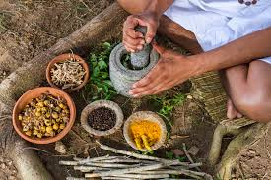
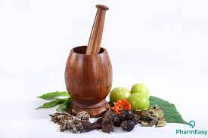
Ayurveda
This section is specially designed for the people who prefer only ayurveda to maintain a healthy life. This section will contain how to do yoga, pranayama and ayurvedic diet rules and regulations.
According to their doshas(vat, pita and kapha) people can get the required solution.
We will also connect ayurvedic practitioners according to their needs.

Slide 8
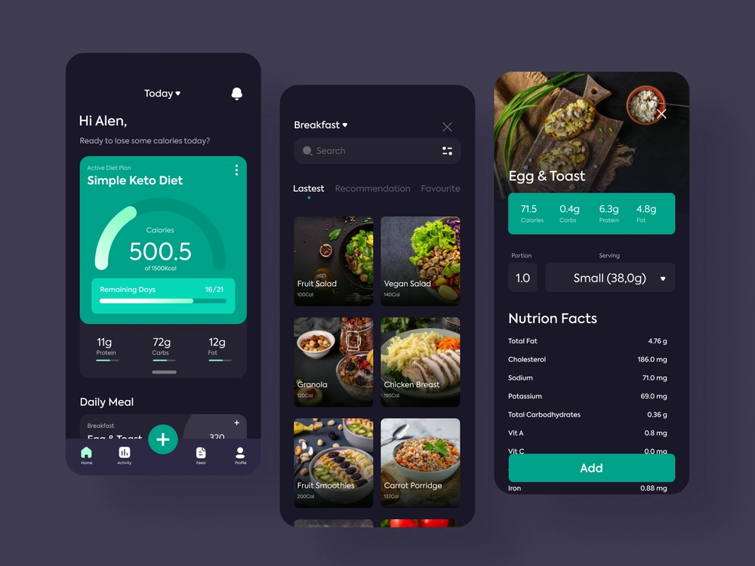
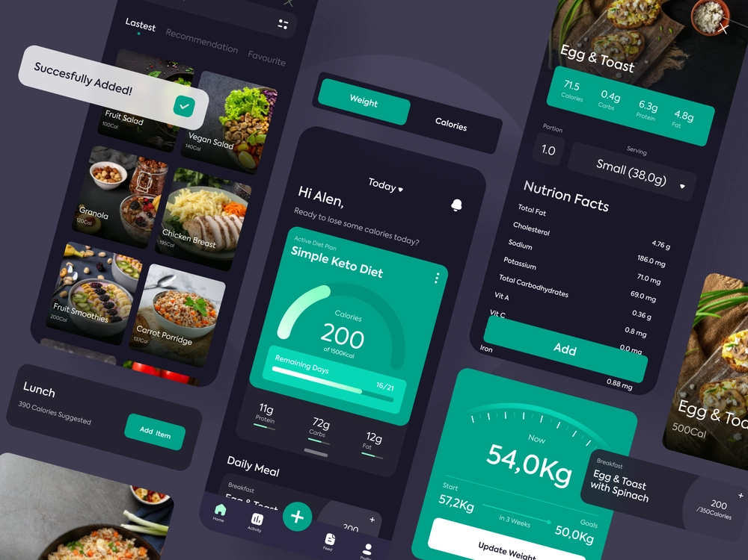
Snapshots of Application

Slide 9



Technologies Used
Android
Java
Kivy
SQL
My SQL Server

Slide 10
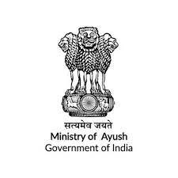



Sources
github.com/MyFoodRepo-273
google.com
ayush.gov.in
kaggle.com

Slide 11
Thank You!
Team TERMINATORS
Prajwal Soni www.linkedin.com/in/Prajwal-soni
Ritesh Lavti www.linkedin.com/in/riteshlavti
Prerit Goyal www.linkedin.com/in/preritgoyal
Priyal Khandelwal www.linkedin.com/in/priyalkwal

